Slide 1

MealMitra: Food Donation Platform

Slide 2

Team Details
Section | Student Name | Roll No | Team Leader
A4 | Udit Raj Kumar | 2310030232 | ✅
A4 | K. Hema Charan Reddy | 2310030419
A4 | M. Nihar Reddy | 2310030441
A4 | K. Dheeraj | 2310030444

Slide 3
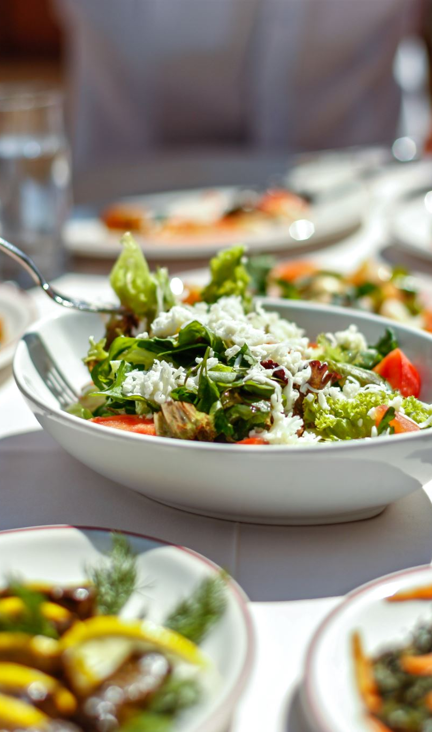
Problem Statement
Many people in India suffer from hunger, while a lot of food is wasted every day.
To solve this, we created a simple website to connect food donors with needy people.
Restaurants, homes, and events can donate extra food to orphanages, old-age homes, and the poor.
The website helps find nearby needy people and ensures food reaches them quickly.
This will reduce food waste and feed the hungry, making a big difference in society!

Slide 4
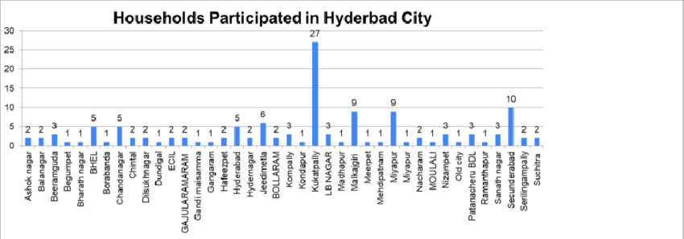
Analysis
As we observe, a significant amount of food is wasted daily in Hyderabad, while many people struggle with hunger.
According to the 2021 records, out of every 30 people in Hyderabad, 27 waste food. Among all areas, Kukatpally has the highest percentage of food wastage.

Slide 5
Analysis of Hungry People
India ranks 111th out of 125 countries in the Global Hunger Index 2023, indicating severe hunger issues.
1
Over 224 million people in India suffer from malnutrition.
2
The World Bank reports that over 14% of India’s population is undernourished.
3

Slide 6
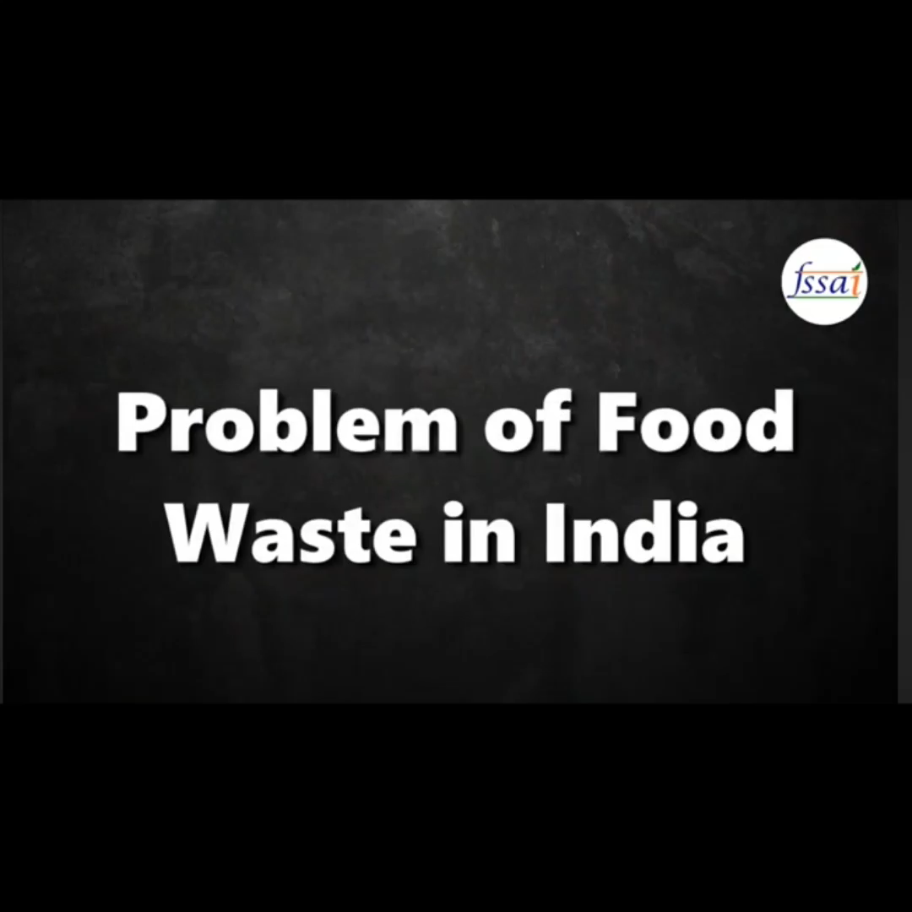
Video As per 2019 Records

Slide 7
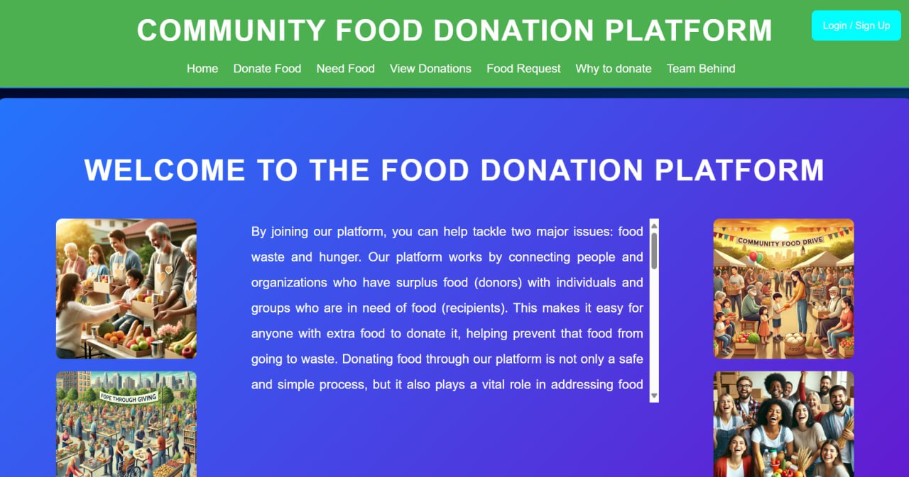
Solution
To address this issue, we have developed a user-friendly website called Community Food Donation Platform (CFDP). This platform allows users to find available food donations based on their location. Anyone in need can collect food from nearby donors, ensuring it reaches the right people. Users can also donate excess food easily, preventing wastage and helping the hungry. With CFDP, we aim to reduce food waste and fight hunger, making a positive impact on society.
If the food wasted or Expired we will Sell to Gov or Private Companies To make farming needs.

Slide 8
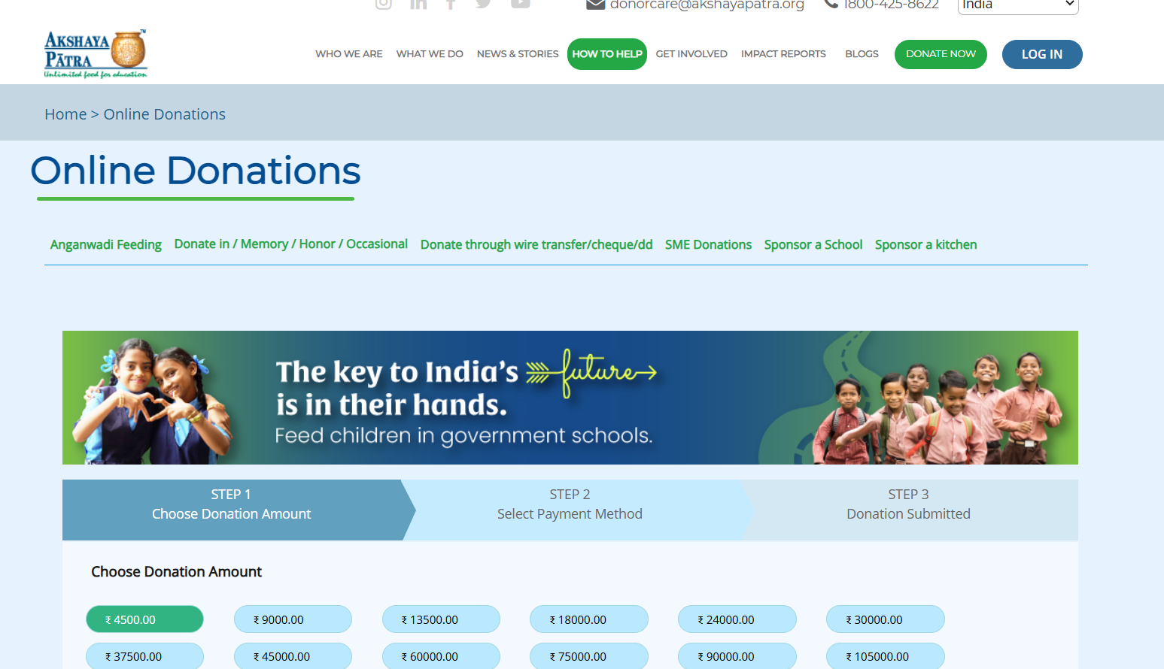
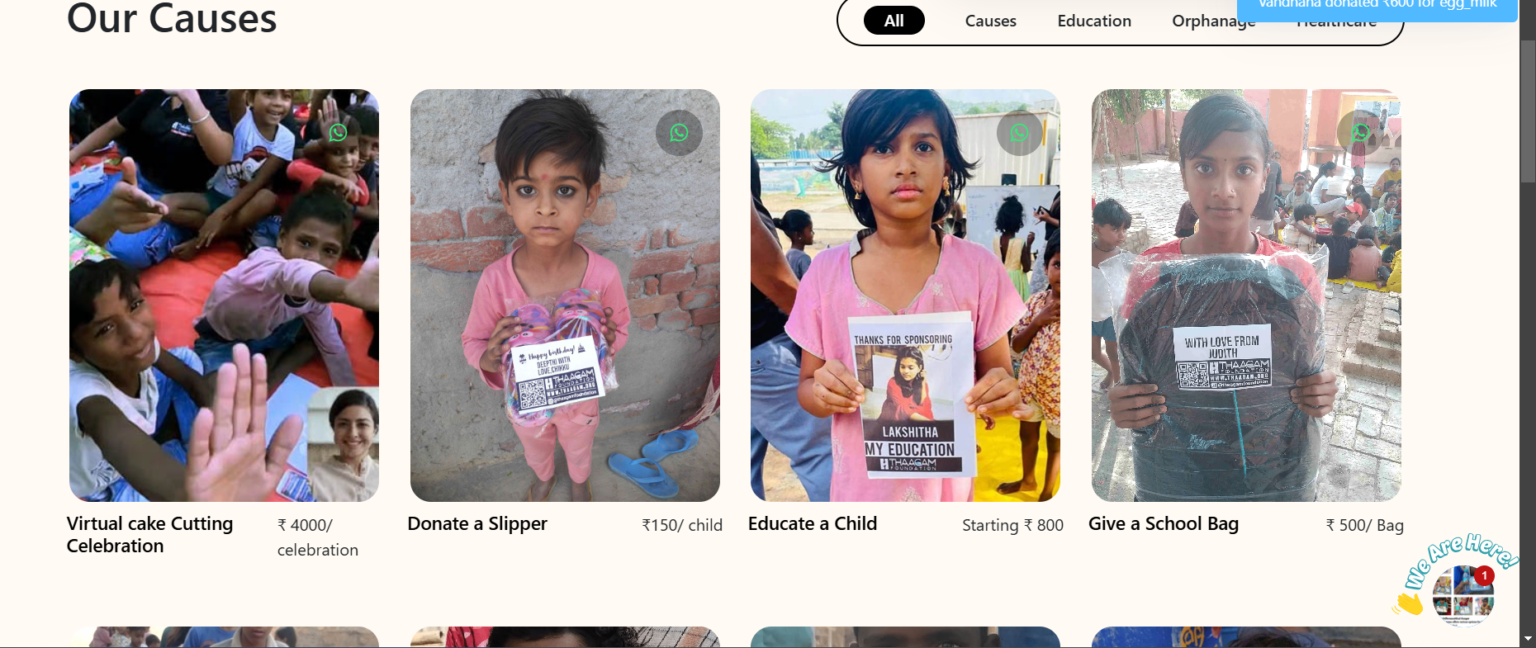
How It is Different From Other Websites
Websites like Thaagam and Akshaya Patra facilitate food donations but primarily operate by collecting money from donors to provide meals. In contrast, our platform, Community Food Donation Platform (CFDP), enables direct user-to-user connections, allowing people to donate food directly to those in need without intermediaries. This ensures faster, more transparent, and effective food distribution, reducing both food waste and hunger.

Slide 9
Stakeholders
Donors – Individuals, restaurants, and businesses that contribute surplus food.
1
Recipients – Orphanages, old-age homes, NGOs, and needy individuals who receive the food.
2
Volunteers – Help in collecting, transporting, and distributing food to the right people.
3
Technology & Logistics – Developers manage the platform, and delivery partners assist in food transport.
4
Government & NGOs – Support food safety, regulations, and awareness to ensure effective food distribution.
5

Slide 10

Thank You!!

